Slide 1
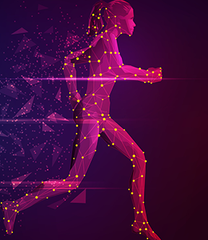
Human Activity Recognition
Team Members
Mounika Sri Sai Apurva Nemalipuri
Dinesh Kothandaraman

Slide 2

Project Topic:
Implementing Human Activity Recognition for jail activity on Videos captured by the surveillance camera using CNN-LSTM in TensorFlow.
2

Slide 3


Objective:
The primary objective is to develop an AI system capable of recognizing human actions in videos. This includes identifying and categorizing actions such as “Fighting“, “Shooting“, and “Stabbing" from video footage captured in the jail surveillance Camera .

Slide 4

Approach
The project aims to leverage TensorFlow and its Keras API to construct a CNN-LSTM architecture for human activity recognition in videos. This involves preprocessing video data by extracting frames, normalizing pixel values, and generating sequences. The CNN layers will be designed and configured to extract spatial features from video frames, while LSTM layers will capture temporal dependencies and sequence information. Training will involve batch processing, dropout, and optimization techniques like the Adam optimizer to enhance model performance. Evaluation will be conducted using metrics such as accuracy, precision, recall, and F1-score to assess the model's effectiveness in recognizing human activities accurately.

Slide 5
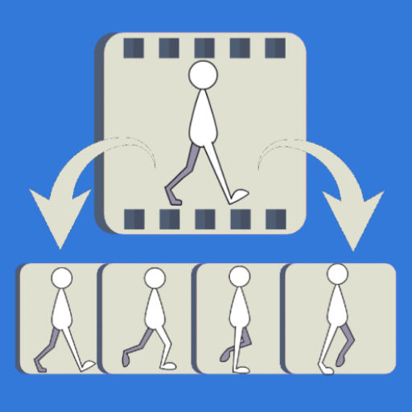
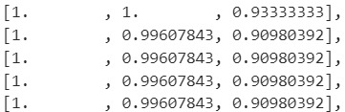
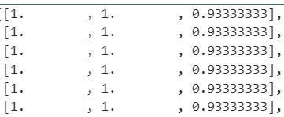

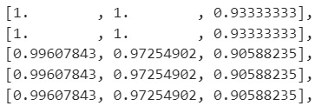

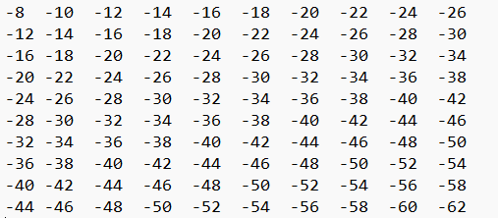

Functional Flowchart
Convolution
C
N
N
Action ’n’
Polling
Action3
LSTM
LSTM
LSTM
Action2
LSTM
Dropout
LSTM
LSTM
Feature Map:
Action1

Slide 6
Frame Extraction, Conversion and Resizing
To get data ready for human activity recognition in a CNN+LSTM model, we follow a few steps. First, we extract frames from videos using OpenCV. This means we collect different snapshots from the videos to understand what's happening visually. Next, we adjust these frames to be the same size and format. We do this so that the computer can easily understand and analyze them. We also make sure all colors and details are in a consistent range. This helps the computer compare and learn from the frames effectively. These steps, though technical, are essential to make sure our AI model can recognize human activities accurately.

Slide 7
Data Splitting for Model Training
In our model training process, we split our dataset into training and testing subsets for effective evaluation. First, we calculate the dataset's size (num_samples = len(features)) to understand its distribution. Then, we set a test size (test_size = max(0.25, 1 / num_samples)) to ensure a balanced split. Using train_test_split from skearn_model_selection library, we divide features (X) and labels (y) into X_train, y_train for training and X_test, y_test for testing, ensuring reproducibility with random_state=42. This method ensures our model learns from one set and tests on another, vital for accurate performance assessment.

Slide 8
Convolutional Neural Networks(CNNs)
Convolutional Neural Networks (CNNs) are vital for recognizing human activities by using advanced techniques for understanding visual data. They automatically learn and identify important features from input data, like images from videos. A CNN's structure includes different layers, such as convolutional layers that detect patterns, pooling layers that simplify data for faster processing, activation layers for recognizing complex patterns, and fully connected layers for making decisions based on what's learned.
Our CNN model is designed to process sequential video data efficiently for recognizing human activities. It starts with Conv3D layers to detect spatial features like edges and textures, followed by MaxPooling3D layers to reduce complexity while retaining important information. Dropout layers prevent overfitting, and Dense layers handle classification tasks, outputting probabilities for different activities.
During training, we use the Adam optimizer and categorical cross-entropy loss function. With 50 training epochs and a batch size of 4, the model learns from the training data and is evaluated using metrics like accuracy. This trained CNN model is then capable of recognizing human activities from video inputs, making it useful in applications such as video surveillance, sports analysis, and healthcare monitoring.

Slide 9
Long Short-Term Memory
Long Short-Term Memory (LSTM) networks are special neural networks that handle sequences of data, making them great for recognizing human activities. Unlike basic neural networks, LSTMs can remember information for a long time, understanding patterns and connections in data that change over time.
In human activity recognition, LSTMs are trained with sequences of prepared data, like frames from videos that have been adjusted for consistency. Through training, LSTMs learn time-related patterns, accurately predicting and categorizing human activities.
Our LSTM model combines CNNs' strength in understanding visual features with LSTMs' ability to grasp patterns over time. When creating the LSTM model, we shape the input based on the CNN's output dimensions, considering factors like sequence length (frames) and CNN output size. The model includes a TimeDistributed layer, an LSTM layer with 64 units, and a Dense layer for classification using softmax.
For training, we use categorical cross-entropy loss, Adam optimizer, and accuracy metrics. The training involves reshaping CNN output data for the LSTM, with parameters like 50 epochs, batch size of 4, and 20% validation split for accuracy checks.

Slide 10
Evaluation Methodology
Generate output videos where the recognized activities are visually overlaid or annotated on the original video frames, showcasing the model's ability to detect and label activities in real-time scenarios. Evaluate the model's performance on the test set using standard metrics such as accuracy, precision, recall, and F1-score.

Slide 11

GitHub Repo:
https://github.com/Dinesh-Kothandaraman/AI-Project-Repo---Team-M-D.git

Slide 12
Thank You

